Slide 1
Azure Storage Services
Ajay Choudhary

Slide 2
Azure Blobs: A massively scalable object store for text and binary data. Also includes support for big data analytics through Data Lake Storage Gen2.
Azure Files: Managed file shares for cloud or on-premises deployments.
Azure Elastic SAN (preview): Azure Elastic storage area network (SAN) is Microsoft's answer to the problem of workload optimization and integration between your large scale databases and performance-intensive mission-critical applications. A fully integrated solution that simplifies deploying, scaling, managing, and configuring a SAN in Azure.
Azure Queues: A messaging store for reliable messaging between application components.
Azure Tables: A NoSQL store for schemaless storage of structured data.
Azure Disks: Block-level storage volumes for Azure VMs.
Azure NetApp Files: Enterprise files storage, powered by NetApp: makes it easy for enterprise line-of-business (LOB) and storage professionals to migrate and run complex, file-based applications with no code change. Azure NetApp Files is managed via NetApp accounts and can be accessed via NFS, SMB and dual-protocol volumes.
Azure Storage data services

Slide 3
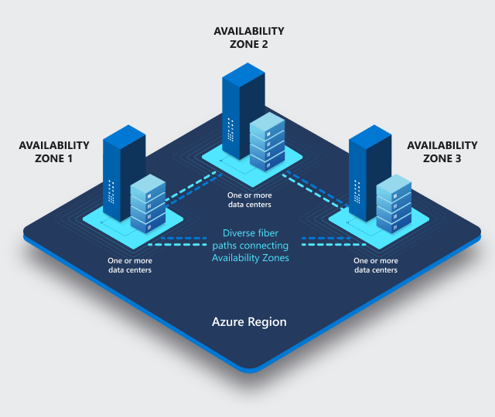
Regions
Each Azure region features datacenters deployed within a latency-defined perimeter. They're connected through a dedicated regional low-latency network. This design ensures that Azure services within any region offer the best possible performance and security.
Availability zones
Failures can range from software and hardware failures to events such as earthquakes, floods, and fires. Tolerance to failures is achieved because of redundancy and logical isolation of Azure services. To ensure resiliency, a minimum of three separate availability zones are present in all availability zone-enabled regions.

Slide 4
Redundancy
in the primary region
Locally redundant storage (LRS) copies your data synchronously three times within a single physical location in the primary region. LRS is the least expensive replication option, but isn't recommended for applications requiring high availability or durability.
Zone-redundant storage (ZRS) copies your data synchronously across three Azure availability zones in the primary region. For applications requiring high availability, Microsoft recommends using ZRS in the primary region and replicating to a secondary region.
in a secondary region
Geo-redundant storage (GRS) copies your data synchronously three times within a single physical location in the primary region using LRS. It then copies your data asynchronously to a single physical location in the secondary region.
Geo-zone-redundant storage (GZRS) copies your data synchronously across three Azure availability zones in the primary region using ZRS. It then copies your data asynchronously to a single physical location in the secondary region. Within the secondary region, your data is copied synchronously three times using LRS.

Slide 5
Types of storage accounts
Type of storage account | Supported storage services | Redundancy options
Standard general-purpose v2 | Blob Storage (including Data Lake Storage), Queue Storage, Table Storage, and Azure Files | LRS, GRS, RA-GRS, ZRS, GZRS, RA-GZRS
Premium block blobs | Blob Storage (including Data Lake Storage) | LRS, ZRS
Premium file shares | Azure Files | LRS, ZRS
Premium page blobs | Page blobs only | LRS

Slide 6
Data stored in the cloud grows at an exponential pace. To manage costs for your expanding storage needs, it can be helpful to organize your data based on how frequently it will be accessed and how long it will be retained. Azure storage offers different access tiers so that you can store your blob data in the most cost-effective manner based on how it's being used. Azure Storage access tiers include:
Hot tier - An online tier optimized for storing data that is accessed or modified frequently. The hot tier has the highest storage costs, but the lowest access costs.
Cool tier - An online tier optimized for storing data that is infrequently accessed or modified. Data in the cool tier should be stored for a minimum of 30 days. The cool tier has lower storage costs and higher access costs compared to the hot tier.
Archive tier - An offline tier optimized for storing data that is rarely accessed, and that has flexible latency requirements, on the order of hours. Data in the archive tier should be stored for a minimum of 180 days.

Slide 7
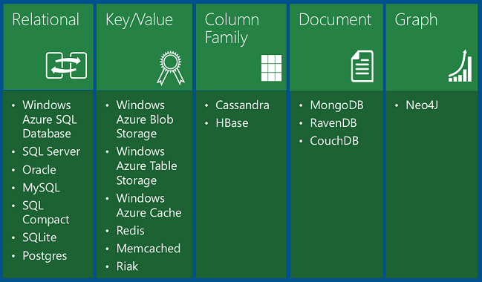
Data storage options on Azure

Slide 8

Azure SQL is a family of managed, secure, and intelligent products that use the SQL Server database engine in the Azure cloud.
Azure SQL Database: Support modern cloud applications on an intelligent, managed database service, that includes serverless compute.
Azure SQL Managed Instance: Modernize your existing SQL Server applications at scale with an intelligent fully managed instance as a service, with almost 100% feature parity with the SQL Server database engine. Best for most migrations to the cloud.
SQL Server on Azure VMs: Lift-and-shift your SQL Server workloads with ease and maintain 100% SQL Server compatibility and operating system-level access.

Slide 9
Demo Azure Storage Services

Slide 10


Usefull Links
Azure Storage Explorer - https://azure.microsoft.com/en-us/products/storage/storage-explorer
Microsoft Training Courses - https://learn.microsoft.com/en-us/training/
Technical documentation - https://learn.microsoft.com/en-us/docs/

Slide 11
Thank you
Ajay Choudhary
ajay.choudhary@zensar.com
Microsoft Certification's Completed

